Slide 1
Phase 3 Thematic Module Physical Capabilities Phase 4 Physical Capabilities Practical Application

Slide 2
Phase 3 Thematic Module Physical Capabilities
This workshop focuses on the Physical capabilities Module
Definition of Physical capabilities
Notes:
Physical Capabilities refer to the degree to which a person can manage the physical tasks of daily living. These capabilities can be compromised by three categories of physical disabilities commonly found in children (1) physical disabilities that result from the spinal cord and column (traumatic spinal cord injuries, spina bifida and spinal column deviations), (2) physical disabilities that are caused to various parts of the brain (cerebral palsy and traumatic brain injury), and (3) amputations. (Block, 2016). Definitions of these disabilities can be found in the glossary.

Slide 3
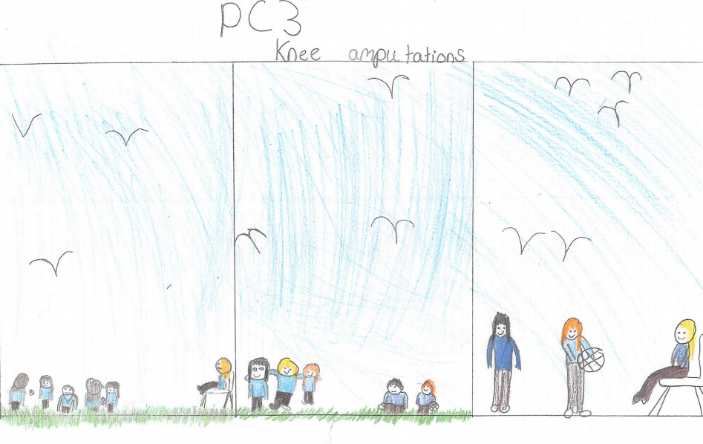
What does the image, drawn by a child, convey? Discuss
Notes:
Mark

Slide 4
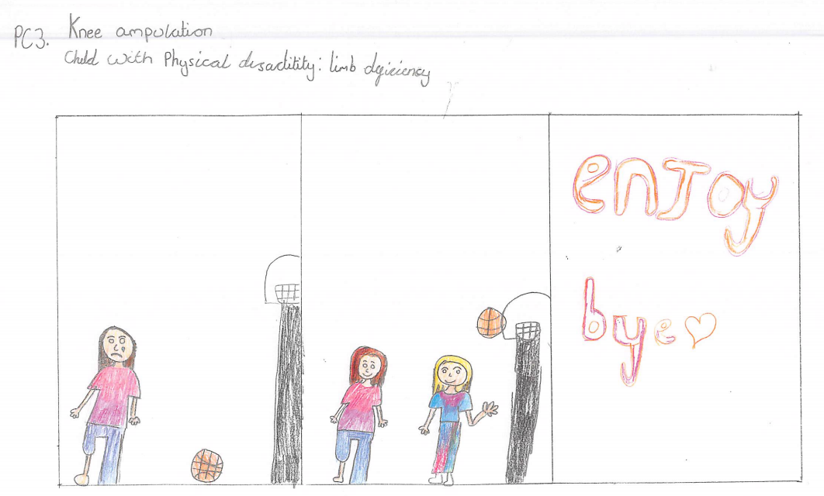
What does the image, drawn by a child, convey? Discuss
Notes:
Mark

Slide 5
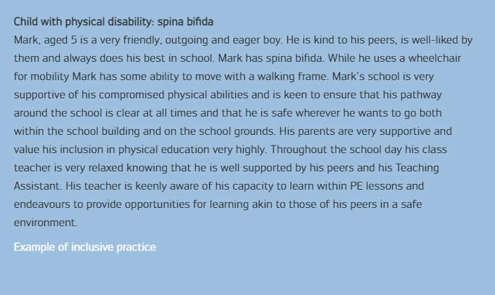
Scenario 1 Mark

Slide 6
Including Mark: Discuss
(a) Can you identify what Mark CAN do from reading the scenario presented?
(b) Let’s talk about what challenges arise for Mark in his everyday life in school?
(c) Now let’s examine what challenges arise for Mark in his PE lessons?
Notes:
Here are additional questions to prompt discussion using the Inclusion process at your workshop
You may wish to select 2/3 questions below and insert them in the slide itself to support a, b, and c, above.
What practices do you use in your PE lessons?
What strategies might support you in teaching students like Mark?
How do you communicate with Mark’s peers to support him?
Is there anything that teachers should avoid?
Is there anything that teachers should be aware of?
Could you suggest some possible solutions or examples of good practice?
Would your strategies/solutions work in athletics, sports/games, swimming…or would they differ?

Slide 7
Including Mark: Reflect
What means or methods of engagement, representation, action and expression are evident in this example?
Engagement: How can you keep their interest? (e.g. offering choice and autonomy, using a variety of equipment, modifying the rules or organisation of a game)
Representation: How can you present your activity in different ways? (e.g. using teacher demonstrations, peer demonstrations, task cards, media clips)
Action and Expression: How can the children demonstrate what they know? (e.g. offering choice in how they execute skills, providing opportunities for self-regulated movement)
Notes:
Facilitator Notes UDL Principles​
Engagement/The why of learning: How can you engage your students, how can you keep their interest (e.g. offering choice and autonomy, using a variety of equipment, modifying the rules or organisation of a game).​
​
Representation/The what of learning: How can you show the information/present your activity/explain your activity in different ways (e.g. use of teacher demonstrations, peer demonstrations, task cards, media clips).​
​
Action and Expression/The how of learning: How can the students demonstrate what they know (e.g. offer choice in how they execute skills, providing opportunities for self-regulated movement).​
​

Slide 8
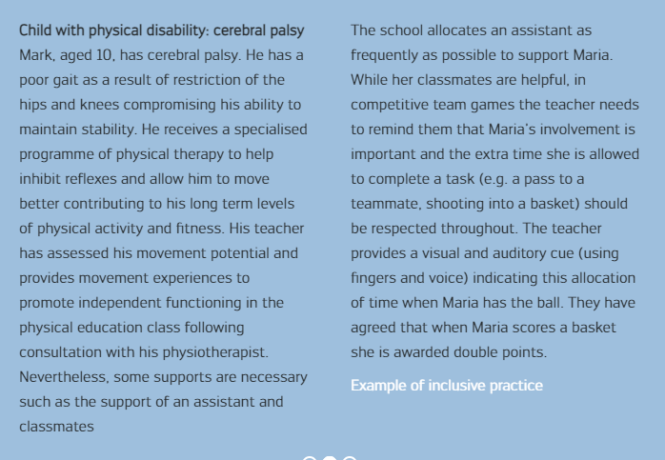
Scenario 2 Maria

Slide 9
Including Maria: Discuss
(a) Can you identify what Maria CAN do from reading the scenario presented?
(b) Let’s talk about what challenges arise for Maria in her everyday life in school?
(c) Now let’s examine what challenges arise for Maria in her PE lessons?
Notes:
Here are additional questions to prompt discussion using the Inclusion process at your workshop
You may wish to select 2/3 questions below and insert them in the slide itself to support a, b, and c, above.
What practices do you use in your PE lessons?
What strategies might support you in teaching students like Maria?
How do you communicate with Maria’s peers to support her?
Is there anything that teachers should avoid?
Is there anything that teachers should be aware of?
Could you suggest some possible solutions or examples of good practice?
Would your strategies/solutions work in athletics, sports/games, swimming…or would they differ?

Slide 10
Including Maria: Reflect
What means or methods of engagement, representation, action and expression are evident in this example?
Engagement: How can you keep their interest? (e.g. offering choice and autonomy, using a variety of equipment, modifying the rules or organisation of a game)
Representation: How can you present your activity in different ways? (e.g. using teacher demonstrations, peer demonstrations, task cards, media clips)
Action and Expression: How can the children demonstrate what they know? (e.g. offering choice in how they execute skills, providing opportunities for self-regulated movement)
Notes:
Facilitator Notes UDL Principles​
Engagement/The why of learning: How can you engage your students, how can you keep their interest (e.g. offering choice and autonomy, using a variety of equipment, modifying the rules or organisation of a game).​
​
Representation/The what of learning: How can you show the information/present your activity/explain your activity in different ways (e.g. use of teacher demonstrations, peer demonstrations, task cards, media clips).​
​
Action and Expression/The how of learning: How can the students demonstrate what they know (e.g. offer choice in how they execute skills, providing opportunities for self-regulated movement).​
​

Slide 11
Phase 4 Physical Capabilities Practical Application
Sports hall or Outdoors

Slide 12
Inclusive Practice: Mark
Now can you focus on the ‘Example of inclusive practice’ illustrating Mark’s engagement?
Are Engagement/Representation/Action and Expression evident in this example?
Child with physical disability: spina bifida
Mark is playing games (‘Magic’ and ‘Trucks and Trailers’) with his classmates. Firstly, they run around the play area changing direction frequently prompted by the teacher. Mark manoeuvres the chair expertly. When the teacher calls out ‘magic’ objects the children have to pause and mime the use of the ‘magic object’. Each ‘object’ can be mimed by Mark using his hands e.g. flying a kite, digging with a shovel, twisting a skipping rope, flying like an aeroplane.
Next the teacher explains that the children will play ‘trucks and trailers’. In pairs all children collect a large ball, beanbag or small ball from buckets placed at four points outside the space. Mark asks if he can collect the ball first to ensure that he can reach the ball at the top of the bucket. Each pair stands one behind the other, so Anna (Mark’s partner) stands behind him. Then they move haphazardly around the space, each pair staying close. The teacher provides a signal (percussion) which means that one child throws the ball or beanbag to his/her partner (a throwing skill) 3 times on hearing the signal. Anna and Mark pause and practise this throwing activity varying the distance of the throw. They then run on with Mark leading.

Slide 13
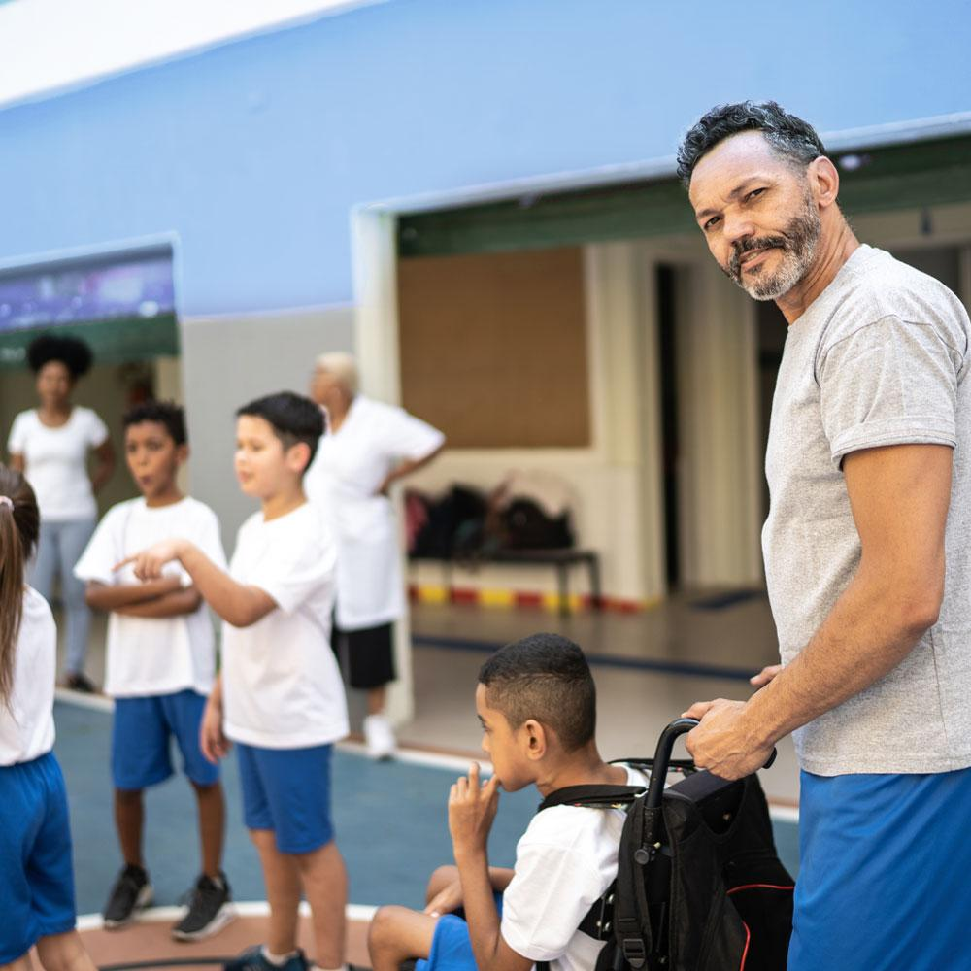
Mark’s Activities
Activity 1
Play ‘Magic’: development of locomotor/body management skills where activities focus on sharing a space while (a) listening and responding independently/individually (b) moving the upper body.
Activity 2
Play ‘Trucks and trailers’: activities focus on (a) locomotor/object control skills: running/wheeling, dodging, throwing and catching; (b) working cooperatively in pairs while sharing space with the whole group.
Equipment: buckets/containers; beanbags and balls; percussion instrument/whistle
Notes:
Activity 1 can act as the warm up? No equipment needed. Firstly, they run around the play area changing direction frequently prompted by the teacher. When the teacher calls out ‘magic’ objects the children have to pause and mime the use of the ‘magic object’. Each ‘object’ can be mimed by Mark using his hands e.g. flying a kite, digging with a shovel, twisting a skipping rope, flying like an aeroplane.
Activity 2 Trucks and Trailers
Equipment:
4 buckets of large balls OR beanbags OR small balls placed at four points along the edges of the sportshall; whistle or percussion instrument. Activity is clear from the slide. Group divided into pairs: A&B. A collects the ball/beanbag from one of the buckets and B joins A once A re-enters the play space.
Reminder to make sure that partners on hearing the signal move apart 2m before throwing/catching.
In pairs all children collect a large ball, beanbag or small ball from buckets placed at four points outside the space. Mark asks if he can collect the ball first to ensure that he can reach the ball at the top of the bucket. Each pair stands one behind the other, so Anna (Mark’s partner) stands behind him. Then they move haphazardly around the space, each pair staying close. The teacher provides a signal (percussion) which means that one child throws the ball or beanbag to his/her partner (a throwing skill) 3 times on hearing the signal. Anna and Mark pause and practise this throwing activity varying the distance of the throw. They then run on with Mark leading.

Slide 14
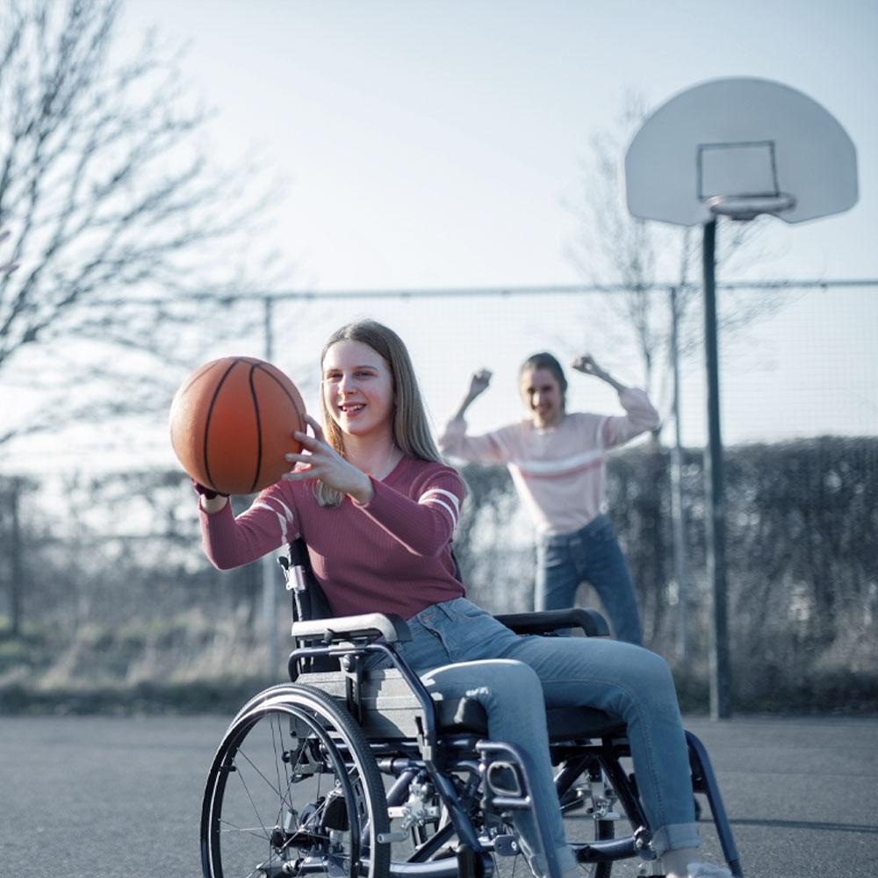
Inclusive Practice: Maria
Now can you focus on the ‘Example of inclusive practice’ illustrating Maria’s engagement?
Are Engagement/Representation/Action and Expression evident in this example?
Maria is included in all PE lessons and her teacher is mindful of her need at times to rest so that her functional ability on the non-affected side of her body will be more efficient as she is not fatigued. During a gymnastics programme she performs some individual balances unaided, some with minimal support but she benefits from the balance/counterbalance activities that she performs with a partner and delights in achieving these. Locomotor tasks though challenging if on a raised surface (e.g. bench) can be supported by a peer or her Teaching Assistant. Sometimes this can mean just walking beside her to enhance her confidence.
She loves parachute games as well as throwing, catching and striking activities. Sometimes she selects a parachute game that she prefers. Her striking and throwing are undertaken using the functional side of her body. She uses a basket on her knees to collect a large ball although she can catch a small ball with one hand. Sometimes her teacher uses the ‘zonal’ approach (see resource section below) in teaching small-sided games (e.g. basketball or Olympic handball) to ensure that Maria can play more effectively as a member of a team. Her manipulation of a wheelchair allows her to partake in these games activities more effectively.
Running activities are very good for her. However, when participating in relay races which she loves, she runs slowly relative to her peers, restricted by her gait. Her teacher modifies the distance so that she can cope better with the challenge. She can manage to pass and receive a baton using the downsweep technique. Maria chooses if she would like to be the lead or anchor runner for example.
Regular allocation of time for the physical education programme ensures that Maria avoids deterioration in performance. Although her individualised therapy programme supports her well, her motivation to perform tasks is heightened in the physical education class due to the social interaction with her classmates.

Slide 15
Maria’s Activities
Warm Up
Activity 1: A throwing, catching and striking game: Bat and Run
Maria plays a game of 3v1 ‘Bat and Run’. Maria bats three tennis ball in succession from base 1. The other 3 children try to retrieve the three balls and return them to a bucket while Maria is moving from base 1 to base 2 (5-10 metres apart). How many ‘runs’ can Maria achieve? She can choose to use her walking aid or her wheelchair to help her achieve the most ‘runs’. She can choose to bat standing or sitting in the wheelchair. Maria then takes her turn on the team of 3 who is retrieving the balls (struck by the next child). She can catch and throw the tennis ball as part of the team of 3 as they try to get all of the balls back to the bucket.
Activity 2: Striking Challenge
Maria begins by practising striking a ball with a bat off the wall. She tries out three different challenges
(i) Strike the ball off the wall letting it bounce before returning it
(ii) Strike the ball off the wall without letting it bounce
(iii) Free play with a ball off the wall: can Maria keep a rally going for 2, then 3 consecutive shots…building on this?
Cool Down
Notes:
Possible Introductory Activity/Warm up: all participants move around the play area bouncing the ball on the bat, off the ground, alternating bouncing on bat/off ground. Can you make a pattern of bounces: high/low/off the ground? Include some dynamic stretches.
Activity 1: Bat and Run
Equipment: cones, polyspots, tennis balls, bats, bucket
Mark out a playing area (size depends on the ball being used: foam or tennis ball?) using cones. Mark base1 using a polyspot. Place another polyspot to the right about 5-10 metres away (base 2). Place a cone behind base 1 to indicate the ‘no go’ zone for safety purposes. Place a bucket 5 metres away from base 1 to the side.
Note: Children can choose to (a) use a batting tee; (b) bounce the ball and bat it, or (c) bat it without a bounce.
Activity 2: Striking Challenge
Equipment: each child should have a bat and a ball. A batting tee may be used.

Slide 16
Sharing Solutions and Strategies
In our groups let’s examine the inclusive practices:
Is engagement evident for all the children?
Are representation, action and expression evident?
Present key solution(s)/strategies and provide a rationale for your choices.
Notes:
This section is open to hear the views of the participants related inclusive practice to ensure that Mark and Maria are provided with the same learning opportunities as all other children. Discussion and sharing can be undertaken in small groups or as a whole group. It is important that the small group will have time to share with the whole group.

Slide 17
References
Using the TREE principles to include http://theinclusionclub.com/resources/tic-videos-2/#1013-tic-videos/924-the-tree-framework
Inspiring stories of people with disabilities http://www.activityalliance.org.uk/how-we-help/resources/filter:Impairments%20and%20Health%20Conditions/page:1?utf8=%E2%9C%93
Using zones in games to promote inclusion NCPHAD. (2015, March, 24). Inclusive Class Design. YouTube. https://www.youtube.com/watch?v=swplZzvkhWk
Adapting activities for a child who is using a walking aid or wheelchair
Niland, E., Barry, M., Dempsey, O., Daly, J. (2010). Best Start: Inclusive Schools Project. Dublin: IWA-Sport/Irish Sports Council. Retrieved from URL January 4 2020.
https://activeschoolflag.ie/wp-content/uploads/2015/08/Irish-Wheelchair-Association-Best-Start-Schools-Inclusion-Project.pdf
Adults orienteering illustrate how a child could do the same
https://www.youtube.com/watch?v=u8ubfvWjY2c https://www.britishorienteering.org.uk/site/trailo/preo
Adapting games for children who are wheelchair users
https://www.playworks.org/resource/adapting-games-for-students-in-wheelchairs/
Capabilities of children in gymnastics
https://www.gymnasticsireland.com/programmes/gymable/video-resources
A teacher explains inclusion of a child
https://theinclusionclub.com/episodes/ Episode 77
Horvat M., Croce, R., Pesce, C., & Fallaize, A. (2019). Developmental and adapted physical education (6th ed.). NY: Routledge.
Block, M. (2016). A teacher’s guide to adapted physical education: Including students with disabilities in sports and recreation (4th ed.). Baltimore: Brookes.

