Slide 1
Phase 3 Thematic Module Sensory
Phase 4 Sensory Practical Application

Slide 2
Phase 3 Thematic Module Sensory
This workshop focuses on the Sensory Module
Definition of Sensory

Slide 3
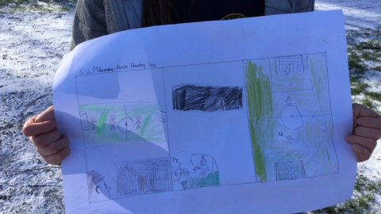
What does the image, drawn by a child, convey? Discuss
Notes:
Bill

Slide 4
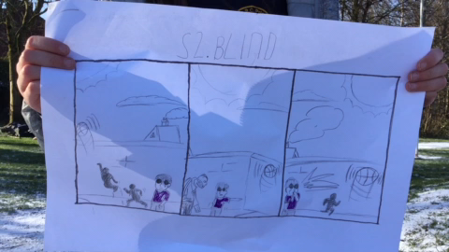
What does the image, drawn by a child, convey? Discuss
Notes:
John

Slide 5
Scenario 1 John

Slide 6
Including John: Discuss
(a) Can you identify what John CAN do from reading the scenario presented?
(b) Let’s talk about what challenges arise for John in his everyday life in school?
(c) Now let’s examine what challenges arise for John in his PE lessons?
Notes:
Here are additional questions to prompt discussion using the Inclusion process at your workshop.
You may wish to select 2/3 questions below and insert them in the slide itself to support a, b, and c, above.
What practices do you use in your PE lessons?
What are your strategies on how you deal with students like John?
How do you communicate with John’s peers to him?
Is there anything that teachers should avoid?
Is there anything that teachers should be aware of?
Could you suggest some possible solutions or examples of good practice?
Would your solutions work in athletics, sports/ games, swimming…or would they differ?

Slide 7
Including John: Reflect
What means or methods of engagement, representation, action and expression are evident in this example?
Engagement: How can you keep their interest? (e.g. offering choice and autonomy, using a variety of equipment, modifying the rules or organisation of a game)
Representation: How can you present your activity in different ways ? (e.g. using teacher demonstrations, peer demonstrations, task cards, media clips)
Action and Expression: How can the children demonstrate what they know? (e.g. offering choice in how they execute skills, providing opportunities for self-regulated movement)
Notes:
Facilitator Notes UDL Principles
Engagement/The why of learning: How can you engage your students, how can you keep their interest (e.g. offering choice and autonomy, using a variety of equipment, modifying the rules or organisation of a game).
Representation/The what of learning: How can you show the information/present your activity/explain your activity in different ways (e.g. use of teacher demonstrations, peer demonstrations, task cards, media clips).
Action and Expression/The how of learning: How can the students demonstrate what they know (e.g. offer choice in how they execute skills, providing opportunities for self-regulated movement).

Slide 8
Scenario 2 Bill

Slide 9
Including Bill: Discuss
(a) Can you identify what Bill CAN do from reading the scenario presented?
(b) Let’s talk about what challenges arise for Bill in his everyday life in school?
(c) Now let’s examine what challenges arise for Bill in his PE lessons?
Notes:
Here are additional questions to prompt discussion using the Inclusion process at your workshop.
You may wish to select 2/3 questions below and insert them in the slide itself to support a, b, and c, above.
What practices do you use in your PE lessons?
What are your strategies on how you deal with students like Bill?
How do you communicate with Bill’s peers to him?
Is there anything that teachers should avoid?
Is there anything that teachers should be aware of?
Could you suggest some possible solutions or examples of good practice?
Would your solutions work in athletics, sports/ games, swimming…or would they differ?

Slide 10
Including Bill: Reflect
What means or methods of engagement, representation, action and expression are evident in this example?
Engagement: How can you keep their interest? (e.g. offering choice and autonomy, using a variety of equipment, modifying the rules or organisation of a game)
Representation: How can you present your activity in different ways ? (e.g. using teacher demonstrations, peer demonstrations, task cards, media clips)
Action and Expression: How can the children demonstrate what they know? (e.g. offering choice in how they execute skills, providing opportunities for self-regulated movement)
Notes:
Facilitator Notes UDL Principles
Engagement/The why of learning: How can you engage your students, how can you keep their interest (e.g. offering choice and autonomy, using a variety of equipment, modifying the rules or organisation of a game).
Representation/The what of learning: How can you show the information/present your activity/explain your activity in different ways (e.g. use of teacher demonstrations, peer demonstrations, task cards, media clips).
Action and Expression/The how of learning: How can the students demonstrate what they know (e.g. offer choice in how they execute skills, providing opportunities for self-regulated movement).

Slide 11
Phase 4 Sensory Practical Application
Sports hall or Outdoors

Slide 12
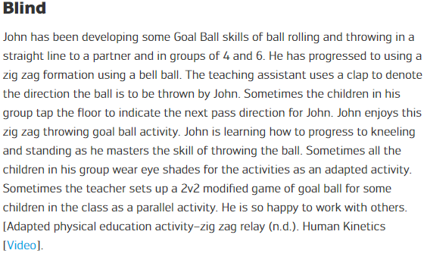
Inclusive Practice: John
Now can you focus on the ‘Example of inclusive practice’ illustrating John’s engagement?
Are Engagement/Representation/Action and Expression evident in this example?

Slide 13
John’s Activities
Sound Ball Rolling (Let’s Play Resource p.36). Rolling a ball to hit as many bowling pins as possible
Zig Zag Relay Passing Activity (Click on title to access YouTube clip)
In groups of 6, sit on the floor in 2 lines 2 metres apart and staggered so the pattern of
passing will be zig zag. Begin by rolling the ball (without wearing eye shades) and knocking on
the floor to indicate the next pass location. After a few attempts, repeat wearing eye shades. Use a
tapping sequence to feel the ball as it approaches. Repeat kneeling and progress to standing
Goalball Yoga (Let’s Play Resource p.38) 2v2 to guard a goal post by preventing balls
from getting into the goal
Notes:
See sample below
Warm up
Parachute with whole class walk and change directions; lift up and down to stretch.
All practice Goal Ball blocking technique lying sideways like pencil to stretch
Change to upright kneeling position with one leg outstretched
1. Sound Ball Rolling (Lets Play Resource p.36). Rolling a ball to hit as many bowling pins as possible
2. In groups of 6, sit on the floor in 2 lines 2 meters apart and staggered so the pattern of passing will be zig zag. Begin by passing/rolling the ball without eye shades and knocking on the floor to indicate the next pass location. After a few attempts repeat with eye shades. Use a tapping sequence to feel for the ball as it approaches. Repeat kneeling and progress to standing
Zig Zag Relay Passing Activity
Goalball Yoga (Lets Play Resource p.38) 2v2 to guard a goal post by preventing balls from getting into the goal.
Cool Down:
Balance and stretch to music

Slide 14
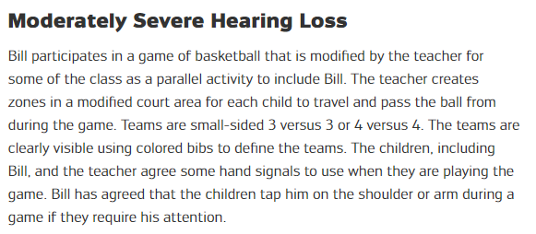
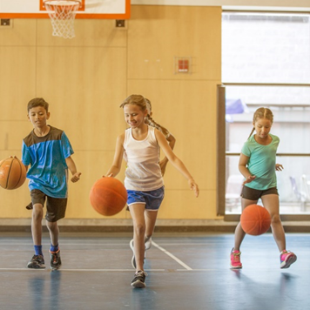
Inclusive Practice: Bill
Now can you focus on the ‘Example of inclusive practice’ illustrating Bill’ s engagement?
Are Engagement/Representation/Action and Expression evident in this examples?

Slide 15
Bill’s Activities
Balance Activities
All children complete balance activities (balance board/balancing on a spot or mat) while walking,
jogging, running, skipping, side stepping. Sign cards or images developed by the children will be
used to direct the activities to communicate e.g. stop, start, listen
Zone Basketball (Adapted from 6 v 6 Zone Football in Let’s Play Together, p.46)
Play the basketball game as 3 v 3
Prepare zones with coloured cones at the zone corners and children wear coloured bibs
Use whiteboard for diagrams to explain the zones or use the image from Let’s Play Together p.46
The play area could be prepared to present options for children e.g. 3 v 3 with no zones
Notes:
See Sample Below
Warm Up
Balance Activities All children complete balance activities (balance board/balancing on a spot or mat) while walking, jogging, running, skipping, side stepping. Sign cards or images developed by the children will be used to direct the activities to communicate e.g. stop, start, listen
Dynamic Stretching using images
Zone Basketball (Adapted from 6 v 6 Zone Football in Let’s Play Together, p.46) Play the basketball game as 3 v 3
Prepare zones with coloured cones at the zone corners and children wear coloured bibs
Use whiteboard for diagrams to explain the zones or use the image from Let’s Play Together p.46
The play area could be prepared to present options for children e.g. 3 v 3 with no zones
Aim to score as many baskets as possible
Players are assigned to specific zones
Participants are to pass the ball to their fellow team mates in the next zone and the player in the final zone tries to score (non contact).
Revise communication sign cards or images
Use whiteboard for diagrams
Cool Down
Cooperative activity

Slide 16
Sharing Solutions and Strategies
In our groups let’s examine the inclusive practices:
Is engagement evident for all the children?
Are representation, action and expression evident?
Present key solution(s)/strategies and provide a rationale for your choices.
Notes:
This section is open to hear the views of the participants related to inclusive practice. However broader discussions related to additional activities arising could be explored. Discussion and sharing can be undertaken in small groups or as a whole group. It is important that the small group will have time to share with the whole group.

Slide 17
References
6v6 Zone Football in Lets Play Together 2015, p.46
http://dippe.wearequattro.com/wp-content/uploads/2020/10/1lets-play-together.pdf
Goalball Yoga in Lets Play Together 2015, p.38
http://dippe.wearequattro.com/wp-content/uploads/2020/10/1lets-play-together.pdf
Sound Ball Bowling in Lets Play Together 2015, p.36
http://dippe.wearequattro.com/wp-content/uploads/2020/10/1lets-play-together.pdf
Human Kinetics. Adapted Physical Education Activity (2014) Zig Zag Relay
https://www.youtube.com/watch?reload=9&v=CJGY88wcQtI

